Slide 1

The Battle of Neighbourhoods Dublin City

Slide 2
Business Problem
Regardless of where you move, some expat problems always seem to pop up. But knowing how to overcome them will help you embrace your exciting new life.
Moving abroad is a big decision and not one to be taken lightly. To leave your comfort zone and be thrust into an entirely new environment, with its own climate, culture, and customs, is a bold move – to say the least. With all these sudden changes, it is hardly surprising that expat problems arise during the tricky adjustment period. The most important ones are to identify a location to stay which is a safe location, has venues that we are looking for & that fits our budget.
Aim
The aim of the project is to look at the different areas ('towns/townland') in the Dublin City and classify locations into different clusters based on the demographic, housing-rental index, venues & crime rate information of each location. Thus, helping a person to decide on a cluster to choose.

Slide 3
Methodology
Business /Requirements understanding
What is the problem you are trying to solve?
Help an Expat to identify the best location to move in.
Analytical approach
How can you use the data to answer the question?
Here we are trying to learn about human behavior, where with the given insights to the data will help them to take a decision. Hence it is appropriate to use Clustering Association approaches.
DATA (Requirements, Collection & Understanding)
What data do you need to answer the question?
Where is the data coming from (identify all sources) and how will you get it?
Is the data that you collected representative of the problem to be solved?
For my exercise, data needed are Crime Data in Dublin City, Population Data, Average Rent in each area, Areas or Towns list with Postal Codes in Dublin & location details of each area. The data is collected from various sources like, dataset available in Kaggle for 'Recorded Crime in Ireland from 2003 to 2019 Garda-wise Quarterly', datasets in gov.ie & cso.ie websites along with dataset prepared with the list of areas in Dublin City data from the wiki pages & Foursquare data for getting popular venues.

Slide 4
Methodology
Data Preparation
Is the data ready to solve the problem or do we need to manipulate the data?
For this project, the data collected from various data sources is combined and the statistics of each location in Dublin is prepared. The dataset is then cleaned to have the data from 2016 to get better insights for the past 5 years. Risk zone category for each area is given & visualized based on the High, Medium & Low risk areas.
Modeling
In what way can the data be inferred to get the required answer?
In this project, I have used the K-MEANS Clustering algorithm to determine the clusters of neighborhoods that are similar in terms or Crime rate, Venues, Population.
Evaluation
since we are using k-means, which requires k as an input and does not learn it from data, there is no right answer in terms of the number of clusters that we should have in any problem. We can evaluate how well the models are performing based on different K clusters.

Slide 5
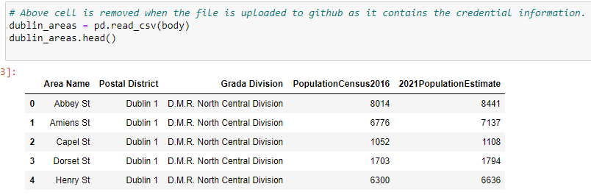
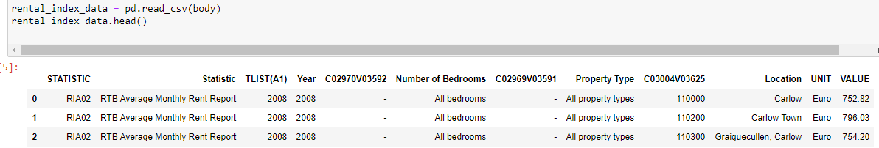
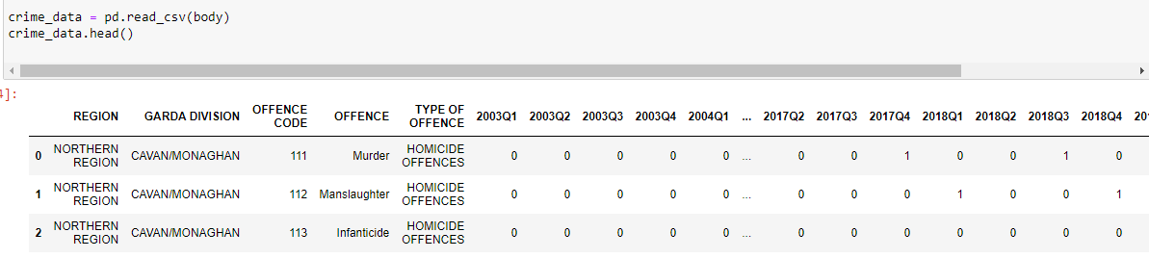
Implementation
Data Requirements
Population data for Dublin City.
Crime rate data for Dublin City.
Average Rental Index for Dublin City.
Popular venues in the area (Foursquare Data).
Data Collection
Using the data from the dataset available in Kaggle for 'Recorded Crime in Ireland from 2003 to 2019 Garda-wise Quarterly' , datasets from cso.ie, data.gov.ie & a list of areas in Dublin City dataset from the wiki pages.

Slide 6
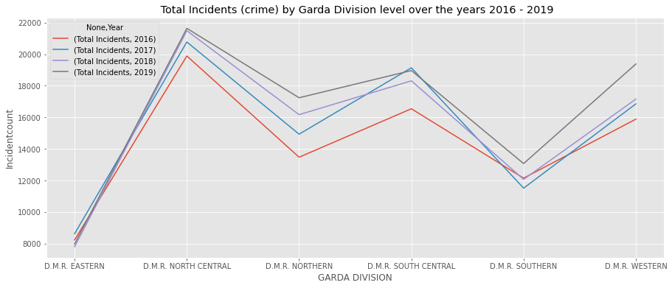
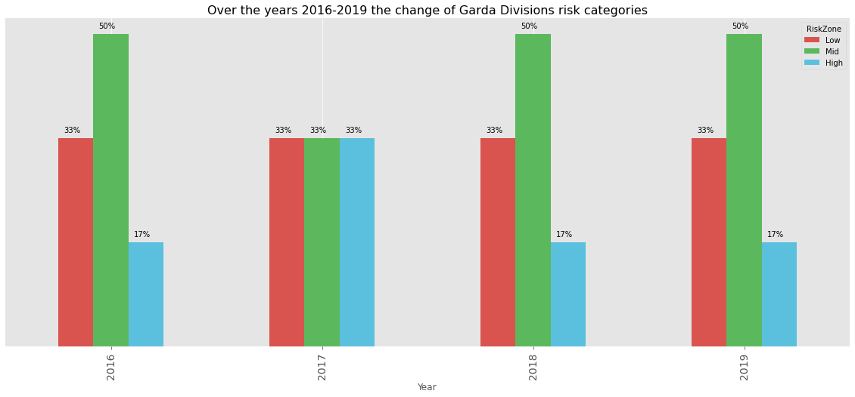
Implementation
Data Understanding - By Visualizations get the trends and analyse the data

Slide 7
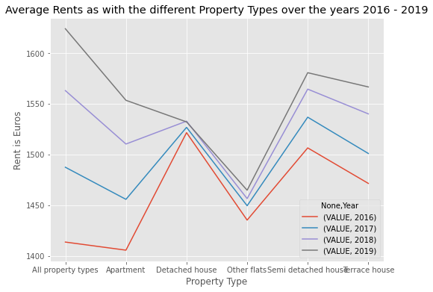
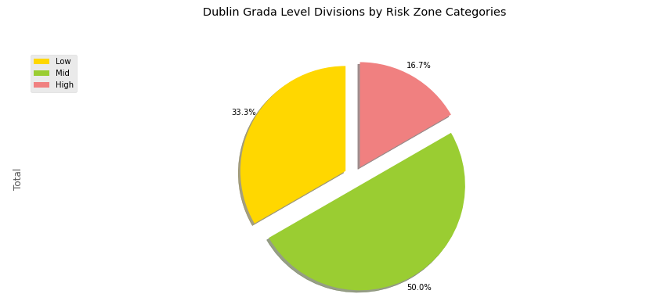
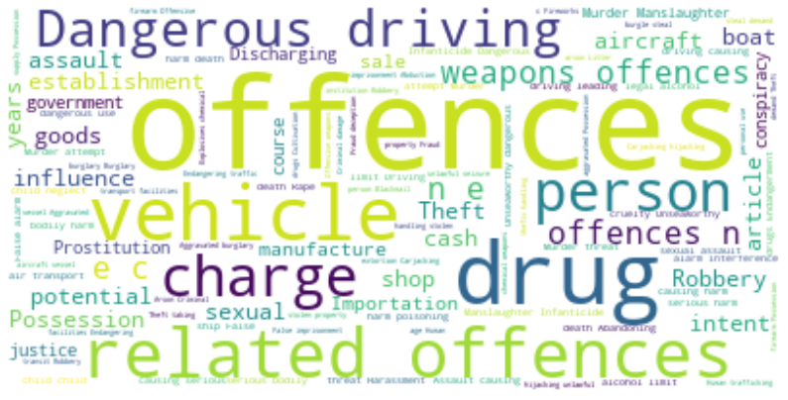
Implementation
Risk Zones in the city
Trends in Rent based on different property type in the city
What are the main types of crime incidents that happen in Dublin? This can be understood by a word cloud of all the type of incidents

Slide 8
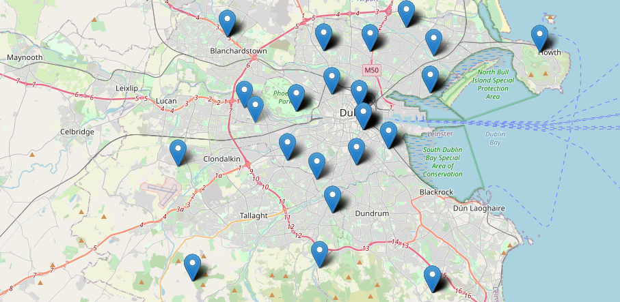
Dublin City Map

Slide 9
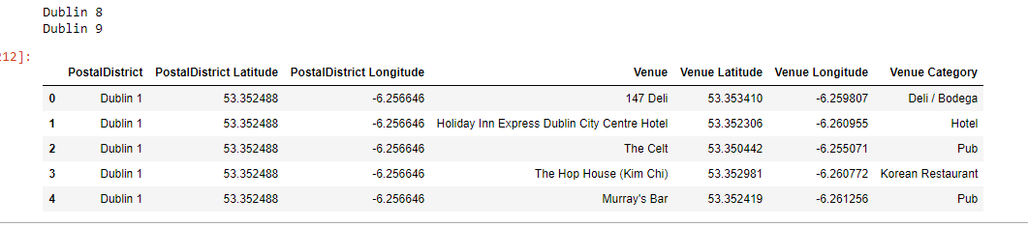
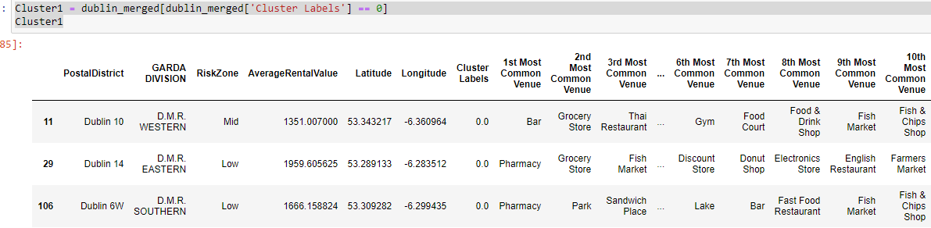
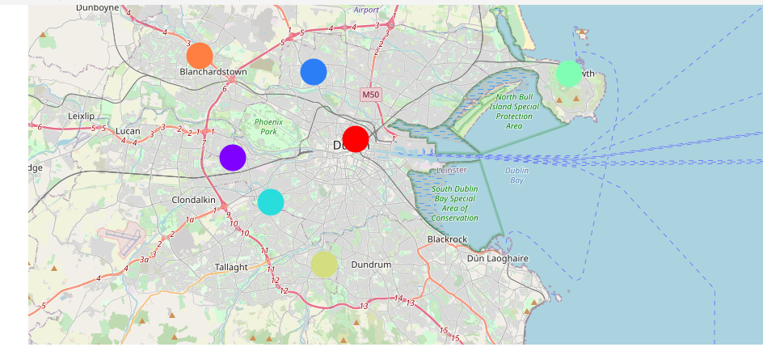
Model – K Means Clustering
Using foursquare

Slide 10
Evaluation & Conclusion
Each cluster gives all the details required for a person to look in. This way we can solve the problem and can help them Identify a place to move in.
If a person must move in, he/she can examine the clusters formed with the details of the main Venues like Pharmacies, Grocery Stores, Departmental Stores, Parks & many more available. Also, in the Clusters formed, we can get the information on average rents, population details crime incident counts in the latest available year (2019) & based on that what is the Risk Zone.
This way we help an individual to give insights to all the necessary information so that an action can be taken.

